Slide 1
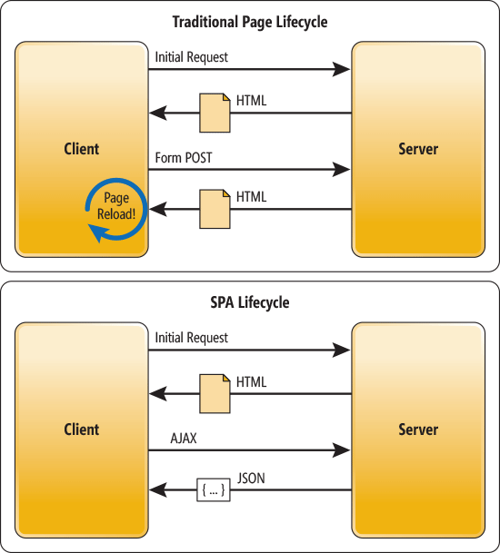
AngularJs + ASP.NET MVC
Hybrid SPA (Single Page Application)

Slide 3
Tools & Libraries
Nuget
AngularJS.Core
AngularJS.Route
bootstrap
jQuery
html5shiv
Respond
Bower
ng-table

Slide 4
Unit Testing
Javascript Unit Tests
Jasmine
angular-mocks
Resharper/Chutzpah + PhantomJS
Controller (MVC + Api) Unit Tests
structuremap
Repository Pattern + DI/IOC
Nunit
Moq
MvcContrib.TestHelper
Notes:
Javascript unit tests
Test Runner - Chutzpah
Install Vs extensions
Chutzpah Test Adapter for the Test Explorer
Chutzpah Test Runner Context Menu Extension
Test Runner – Resharper
Resharper > Options > Tools > Unit Testing > Javascript Tests
Verify Jasmine Support is enabled
Verify Jasmine Version – 2.0
Run Tests with PhantomJS – set the executable path (install phantomJs)
Javascript Unit Tests on Team Foundation Service with Chutzpah
http://blogs.msdn.com/b/visualstudioalm/archive/2012/07/09/javascript-unit-tests-on-team-foundation-service-with-chutzpah.aspx
ASP.NET MVC Unit tests
http://mvccontrib.codeplex.com/wikipage?title=TestHelper

Slide 5
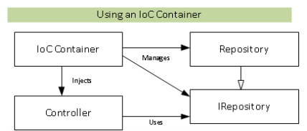
DI/IOC Using StructureMap

Slide 6
Next…
Angular UI Bootstrap
Real-time application using SignalR

